Slide 1
ATTENDANCE MANAGEMENT SYSTEM USING C
Under the guidance of Ms. M Hema

Slide 2
TEAM MEMBERS
Hariharasudhan Arul(Ra2111052010015)
Deepak Ram(RA2111052010006)

Slide 3
PROJECT PROFILE
Attendance Management System is software developed for daily student attendance in schools, colleges and institutes.
It facilitates to access the attendance information of a particular student in a particular class. The information is sorted by the operators, which will be provided by the teacher for a particular class.
This system will also help in evaluating attendance eligibility criteria of a student.

Slide 4
CURRENT SYSTEM
Existing Attendance Management System of the Institute is totally working manually. All the Information’s are handled manually in the registers or other documents.
The process of the work is mainly divided in two parts, first is to take attendance on sheet & enter details into the registers. And then at the end of the session or semester attendance is calculated manually & reports are generated

Slide 5
LIMITATIONS OF THE CURRENT SYSTEM
Wastage of time
Wastage of the human resource
Security of data is less
Accessing any data from the manual system is very difficult
Possibility of occurrence of errors means accuracy is less

Slide 6
PROPOSED SYSTEM
This Application is built for automating the processing of attendance. It also enhances the speed of the performing attendance task easily.
It also possible to check on the students who are regular & who are not
This system is very useful to the office staff also because they can generate various types of reports and submit them to respective faculties also or also can be submitted to the College Coordinator.

Slide 7
ADVANTAGES OF PROPOSED SYSTEM
A Computer can work more efficiently than compared to a human being so human resources are saved
Data accuracy is maintained
Data can be accessed easily and randomly
Unauthorized persons cannot access the data
Saves the time utmost

Slide 8
Hardware Requirements
Pentium 90 MHZ or Faster and 96 MB Ram (Client)
Pentium 133 MHZ or Faster and 128 Ram (Server)
Operating System
Windows XP or any above Windows operating systems
Software Requirements
Codeblocks 20.03 MinGW

Slide 9
FEASIBILITY STUDY
A feasibility study is a short, focused study, which aims to answer a number of questions
Does the system contribute to the overall objectives of the Organization?
Can the system be implemented using current technology and within given cost and schedule constraints?
Can the system be integrated with systems which are already in place?

Slide 10
FEASIBILITY STUDY (CONT..)
All systems are feasible, given unlimited resources and infinite time. It is both necessary and prudent to evaluate the feasibility of the project at System study phase itself. The feasibility study to be conducted for this project Involves.
Technical Feasibility
Operational Feasibility
Economic Feasibility

Slide 11
FEATURES PROVIDED
Admin
Add & Modify details of students
Office Staff
Generate various types of reports
Faculty
Attendance on basis of
day by day

Slide 12
Source Code
https://github.com/Hariarul17/Attendance-management-system-in-c/blob/main/Attendence.c

Slide 13
Screenshots Of The Output

Slide 14
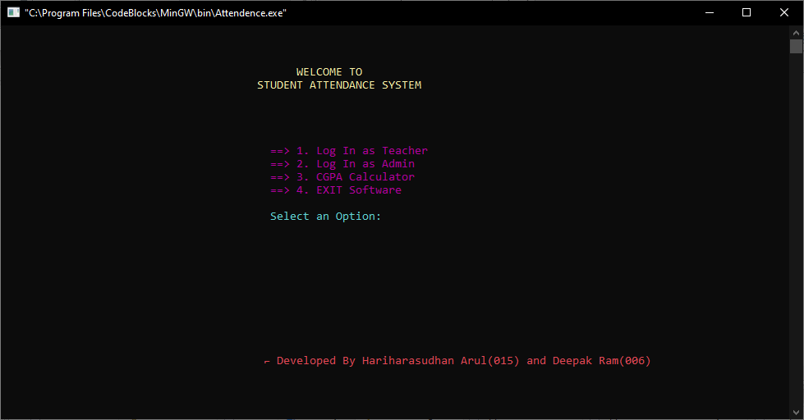

Slide 15
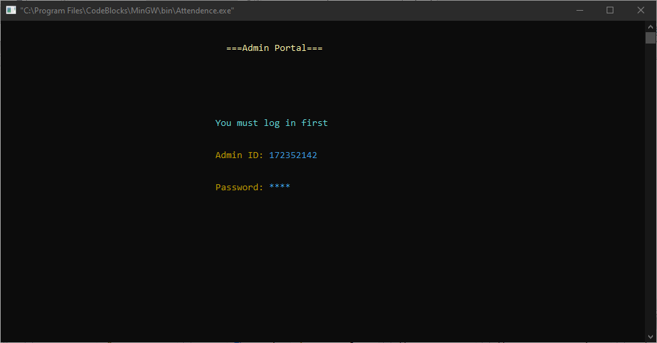

Slide 16
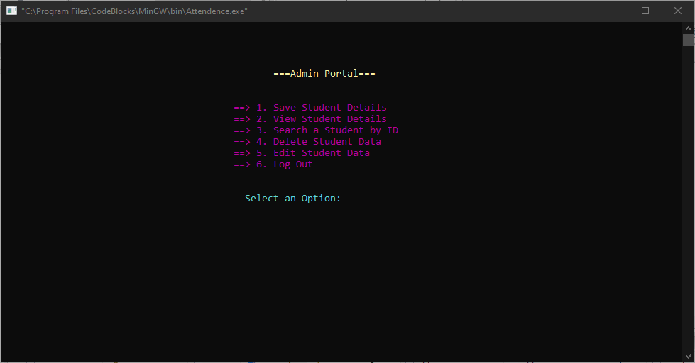

Slide 17
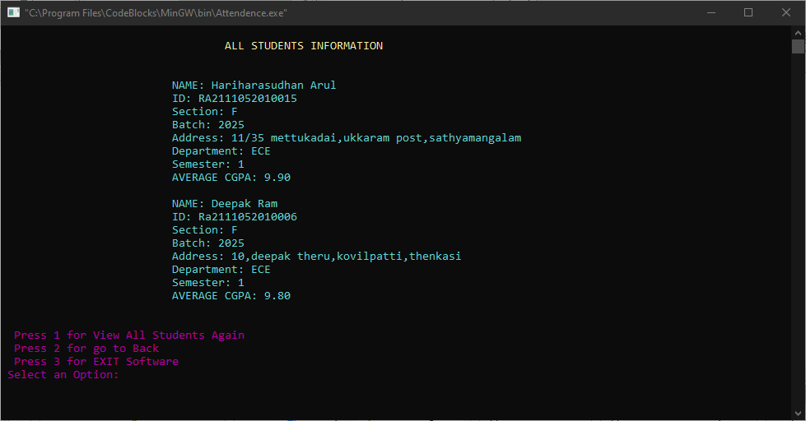

Slide 18
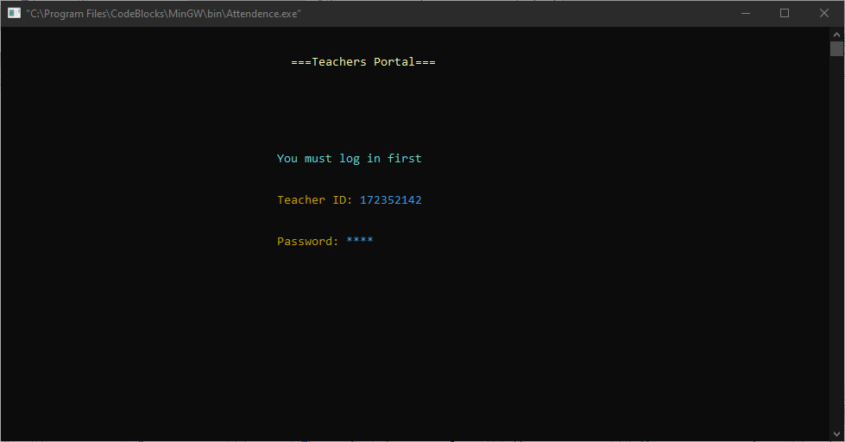

Slide 19
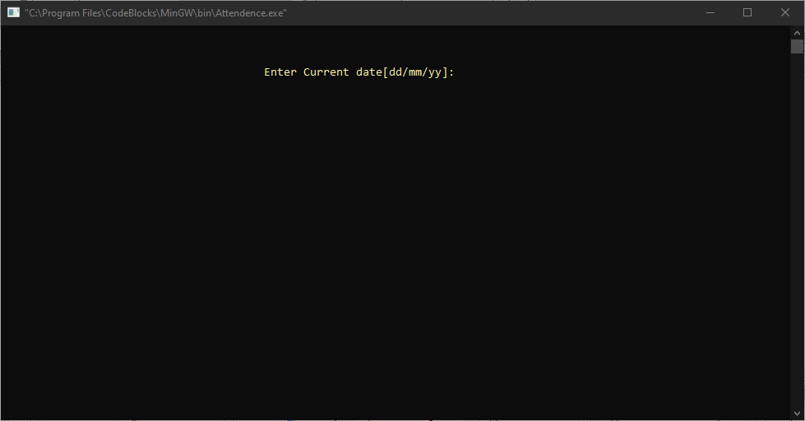

Slide 20
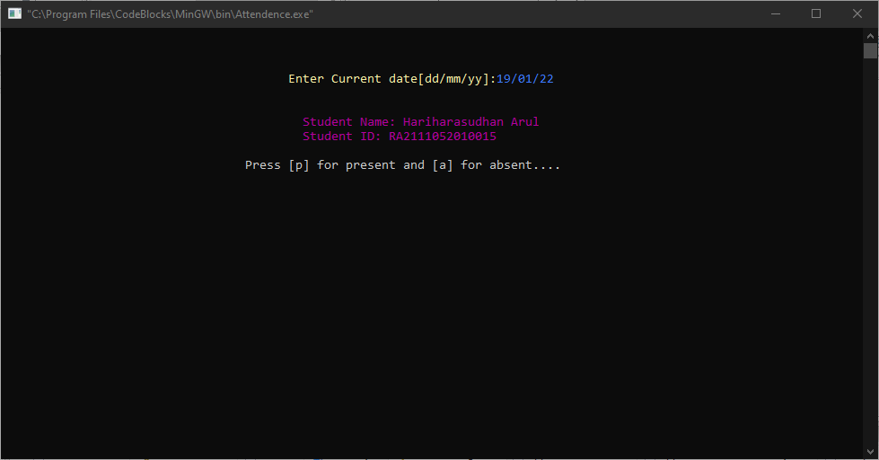

Slide 21
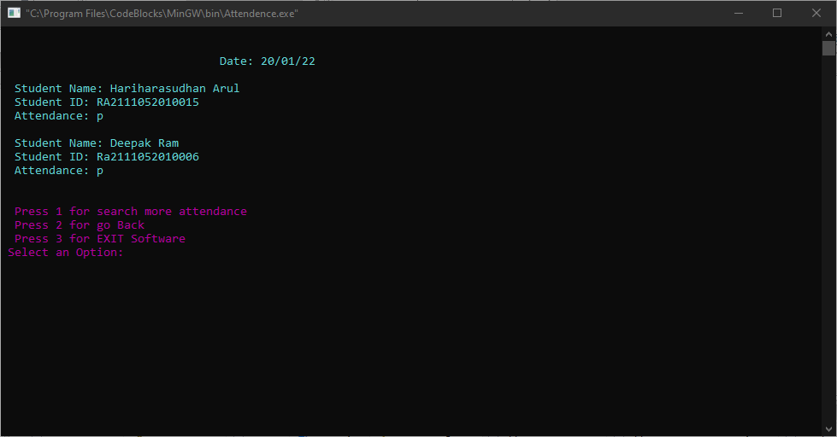

Slide 22
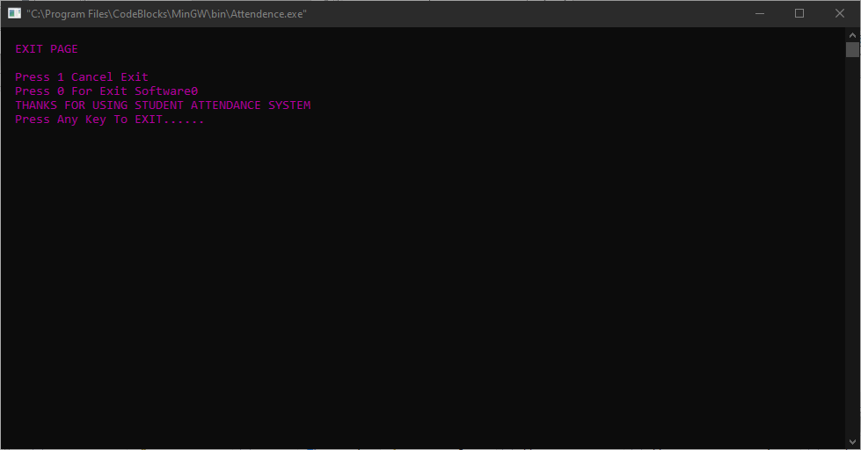

Slide 23
Thank You

